Slide 1
C programming

Slide 2
Acknowledgement
The contents (figures, concepts, graphics, texts etc.) of the slides are gathered and utilized from the books mentioned and the corresponding PPTs available online:
Books:
Let Us C, Yashawant Kanetkar, BPB Publications.
The C Programming Language, B. W. Kernighan, D. Ritchie, Pearson Education India.
Web References:
Problem Solving through Programming in C, Anupam Basu, NPTEL Video Lectures. Link: https://nptel.ac.in/courses/106/105/106105171/
Compile and Execute C Online (Link: https://www.onlinegdb.com/)
Disclaimer: The study materials/presentations are solely meant for academic purposes and they can be reused, reproduced, modified, and distributed by others for academic purposes only with proper acknowledgements.

Slide 3
Variables
Rules for Naming a Variable in C
We give a variable a meaningful name when we create it. Here are the rules that we must follow when naming it:
1. The name of the variable must not begin with a digit.
2. A variable name can consist of digits, alphabets, and an underscore ( _ ).
3. A variable name must not have any keywords, for instance, float, int, etc.
4. There must be no spaces or blanks in the variable name.
5. The C language treats lowercase and uppercase very differently, as it is case sensitive. Usually, we keep the name of the variable in the lower case.
Let us look at some of the examples,
int var1; // it is correct
int 1var; // it is incorrect – the name of the variable should not start using a number
int my_var1; // it is correct
int my$var // it is incorrect – no special characters should be in the name of the variable
char else; // there must be no keywords in the name of the variable
int my var; // it is incorrect – there must be no spaces in the name of the variable
int COUNT; // it is a new variable
int Count; // it is a new variable
int count; // it is a valid variable name

Slide 4
Variables
Variable Definition in C
type variable_list;
Some valid declaration are shown here
int i, j, k;
char c, ch;
float f, salary;
double d;
Variable Initialization
type variable_name = value;
Example: int d = 3, f = 5; //declaration and initializing d and f.
char x = 'x'; // the variable x has the value 'x'.

Slide 5
Variables
Change Variable Values
Example 1
int myNum = 15; // myNum is 15 myNum = 10; // Now myNum is 10
Example 2
int myNum = 15;
int myOtherNum = 23;
// Assign the value of myOtherNum (23) to myNum
myNum = myOtherNum;
// myNum is now 23, instead of 15
printf("%d", myNum);
Example 3
int x = 5;
int y = 6;
int sum = x + y;
printf("%d", sum);

Slide 6
Variables
Types of Variables in C
Classification on the Basis of Scope
Local Variables
Global Variables
Local Variable:
#include <stdio.h>
void function()
{
int x = 10; // local variable
printf("%d", x);
}
int main()
{
function();
}
Output
10

Slide 7
Variables
Types of Variables in C
Classification on the Basis of Scope
Local Variables
Global Variables
Global Variables
#include <stdio.h>
int x = 20; // global variable
void function1() { printf("Function 1: %d\n", x); }
void function2() { printf("Function 2: %d\n", x); }
int main()
{ function1();
function2();
return 0;
}
Output
Function 1: 20
Function 2: 20

Slide 8
Variables
Types of Variables in C
2. Classification on the Basis of Storage Class
Storage Classes in C is the concept that helps us to determine the scope, lifetime, memory location, and default value (initial value) of a variable.
On the basis of storage classes, we can classify the C variables into 4 types:
1. Static Variables
2. Automatic Variables
3. Extern Variables
4. Register Variables

Slide 9
Variables
static variable
#include <stdio.h>
void function()
{
int x = 20; // local variable
static int y = 30; // static variable
x = x + 10;
y = y + 10;
printf("\tLocal: %d\n\tStatic: %d\n", x, y);
}
int main()
{
printf("First Call\n");
function();
printf("Second Call\n");
function();
printf("Third Call\n");
function();
return 0;
}
Output
First Call
Local: 30
Static: 40
Second Call
Local: 30
Static: 50
Third Call
Local: 30
Static: 60

Slide 10
Variables
External Variables
External variables in C can be shared between multiple C files. We can declare an external variable using the extern keyword.
Register Variables
Register variables in C are those variables that are stored in the CPU register instead of the conventional storage place like RAM. Their scope is local and exists till the end of the block or a function.
These variables are declared using the register keyword.
#include <stdio.h>
int main() {
register char x = 'A';
register int a = 10;
register short b = 53;
printf("The value of register variable x : %c\n",x);
printf("The value of register variable a : %d\n",a);
printf("The value of register variable b : %d\n",b);
return 0;
}

Slide 11
"Hello, world" example
#include <stdio.h>
int main(void)
{
printf("hello, world\n");
}

Slide 12
How to compile C Prorgramme?
gcc filename (with .c extension)
-After successful compilation if there is no error, then an executable file will be generated.
The default executable output of GCC is "a.out“
./a.out
gcc filename -o outputfile
To specify a name for the executable file

Slide 13
Example : float and double Output
#include <stdio.h>
int main()
{
float number1 = 13.5;
double number2 = 12.4;
printf("number1 = %f\n", number1);
printf("number2 = %lf", number2);
return 0;
}
Output
number1 = 13.500000
number2 = 12.400000

Slide 14
Example: Integer Output
#include <stdio.h>
int main()
{
int testInteger = 5;
printf("Number = %d", testInteger);
return 0;
}
Output
Number = 5

Slide 15
Example : float and double Output
#include <stdio.h>
int main()
{
float number1 = 13.5;
double number2 = 12.4;
printf("number1 = %f\n", number1);
printf("number2 = %lf", number2);
return 0;
}
Output
number1 = 13.500000
number2 = 12.400000

Slide 16
Example: Print Characters
#include <stdio.h>
int main()
{
char chr = 'a';
printf("character = %c", chr);
return 0;
}
Output
character = a

Slide 17
C Input
In C programming, scanf() is one of the commonly used function to
take input from the user. The scanf() function reads formatted input
from the standard input such as keyboards.
Example: Integer Input/Output
#include <stdio.h>
int main()
{
int testInteger;
printf("Enter an integer: ");
scanf("%d", &testInteger);
printf("Number = %d",testInteger);
return 0;
}
Output
Enter an integer: 4
Number = 4

Slide 18
Example: Float and Double Input/Output
#include <stdio.h>
int main()
{
float num1;
double num2;
printf("Enter a number: ");
scanf("%f", &num1);
printf("Enter another number: ");
scanf("%lf", &num2);
printf("num1 = %f\n", num1);
printf("num2 = %lf", num2);
return 0;
}
Output
Enter a number: 12.523
Enter another number: 10.2
num1 = 12.523000
num2 = 10.200000

Slide 19
Example: C Character I/O
#include <stdio.h>
int main()
{
char chr;
printf("Enter a character: ");
scanf("%c",&chr);
printf("You entered %c.", chr);
return 0;
}
Output
Enter a character: g
You entered g

Slide 20
Example: ASCII Value
#include <stdio.h>
int main()
{
char chr;
printf("Enter a character: ");
scanf("%c", &chr);
// When %c is used, a character is displayed
printf("You entered %c.\n",chr);
// When %d is used, ASCII value is displayed
printf("ASCII value is %d.", chr);
return 0;
}
Output
Enter a character: g
You entered g.
ASCII value is 103.

Slide 21
I/O Multiple Values
#include <stdio.h>
int main()
{
int a;
float b;
printf("Enter integer and then a float: ");
// Taking multiple inputs
scanf("%d%f", &a, &b);
printf("You entered %d and %f", a, b);
return 0;
}
Output
Enter integer and then a float: -3
3.4
You entered -3 and 3.400000

Slide 22
Problems
To find the sum of 5 numbers
To take the marks of 5 subjects of a student. Compute
the total and Average.

Slide 23
Solutions 2
#include <stdio.h>
int main() {
int number1, number2, sum;
printf("Enter two integers: ");
scanf("%d %d", &number1, &number2);
// calculating sum
sum = number1 + number2;
printf("%d + %d = %d", number1, number2, sum);
return 0;
}

Slide 24
Solutions 1
#include <stdio.h>
int main()
{
float eng, phy, chem, math, comp;
float total, average, percentage;
/* Input marks of all five subjects */
printf("Enter marks of five subjects: \n");
scanf("%f%f%f%f%f", &eng, &phy, &chem, &math, &comp);
/* Calculate total, average and percentage */
total = eng + phy + chem + math + comp;
average = total / 5.0;
percentage = (total / 500.0) * 100;
/* Print all results */
printf("Total marks = %.2f\n", total);
printf("Average marks = %.2f\n", average);
printf("Percentage = %.2f", percentage);
return 0;
}

Slide 25
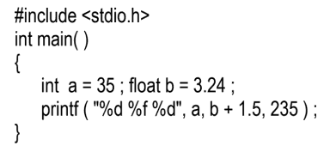

Problems

Slide 26
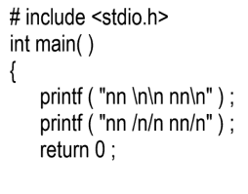
Problems
nn
nn
nn /n/n nn/n

Slide 27
Problems
#include <stdio.h>
void main()
{
char ch;
int i;
ch = 'K';
i = ch - 'B';
printf("%d", i);
}
9

Slide 28
Problems
#include <stdio.h>
int main()
{
int x = 10;
int y = 70;
x = x + y;
y = x - y; x = x - y; printf(“X=%d",x);
printf(“Y=%d",y);
return 0;}
X=70
Y=10

Slide 29
Control Statements

Slide 30
Chapter Objectives
To learn about different types of Control Statements

Slide 31
Chapter Topics
Decision Structures – if statement, if-else statement, nested if statement
The switch statement
Repetition or Iteration structure - for statement, continue statement, nested loop, while loop

Slide 32
Decision making and Branching
To change the order of execution based on certain conditions or repeat a group a statements until certain specified conditions are met.
Any expression can be used as a program statement by following the expression with a ‘;’ (semicolon).
ANSI C has the following categories of statements
Selection – if, switch
Iteration – for, do, while
Jump – continue, break, goto, return
Label – case, default, (goto) label statement
Expression – valid expression
Block – { … } (also called compound statements)

Slide 33
C Control Structure Decision
Compound Statements
{ . . . }
if - else
switch - case
break
break

Slide 34
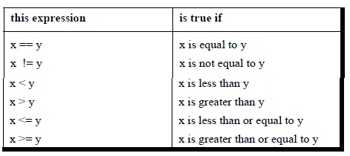
Arithmetic, Relational and Logical Operator

Slide 35
The if Statement
Syntax:
The Syntax available for the if statement will be:
if (condition x)
{
// A block of statements for the C program
// The execution of these statements will only happen when this condition turns to be true
}
There will be an execution of the statements available inside the body of
the if block whenever the given condition returns to be true. In case this
condition returns to be false, then the program will skip the statements
that we have inside the if block.

Slide 36
Example: if condition
if ( this condition is true ) execute this statement ;
Simply:
if(condition) statement;
Or
if(condition)
{
Statement 1;
Statement 2;
…. Statement n;
}

Slide 37
Example: if condition
#include <stdio.h>
int main() {
int num;
printf("Enter an integer: ");
scanf("%d", &num);
// true if num is perfectly divisible by 2
if(num % 2 == 0)
printf("%d is even.", num);
else
printf("%d is odd.", num);
return 0;
}
Enter a number:4
4 is even number

Slide 38
Example: if condition
#include <stdio.h>
main()
{
int x;
printf(“We enter any number:”);
scanf(“%d”, &x);
printf (“The number entered here is %d”, x);
if (x>100)
printf (“Hi. You have entered a comparatively higher number.”);
}
Case #1:
If x = 300,
The output generated here will be:
Hi. You have entered a comparatively higher number.
Case #2:
If x = 50,
The compiler will skip the statement,

Slide 39
#include <stdio.h>
int main() {
double n1, n2, n3;
printf("Enter three different numbers: ");
scanf("%lf %lf %lf", &n1, &n2, &n3);
// if n1 is greater than both n2 and n3, n1 is the largest
if (n1 >= n2 && n1 >= n3)
printf("%.2f is the largest number.", n1);
// if n2 is greater than both n1 and n3, n2 is the largest
if (n2 >= n1 && n2 >= n3)
printf("%.2f is the largest number.", n2);
// if n3 is greater than both n1 and n2, n3 is the largest
if (n3 >= n1 && n3 >= n2)
printf("%.2f is the largest number.", n3);
return 0;
}

Slide 40
The if – else Statement
Structure
if (expression)
statement_1
else
The else part is optional
The expression is evaluated: if expression is TRUE (I.e. non zero) then statement_1. If expression is FALSE (i.e. zero) then statement_2 is executed if present. For multiple if’s, the else goes with the closest if without an else condition.

Slide 41
Contd…
main()
{
int x=0; if(x==0)
printf(“X is zero”);
}
All control statements can be used in conjunction with relational and logical operator.
main()
{
int x=0,y; if(x>0)
{
printf(“X is positive”);
y=x+3; printf(“%d”,y);
}
}

Slide 42
contd..
/* program to check greater between two numbers */ main()
{
int a,b;
printf(“Enter two numbers”); scanf(“%d %d”,&a,&b); if(a>b)
printf(“%d is greater than %d”,a,b);
}

Slide 43
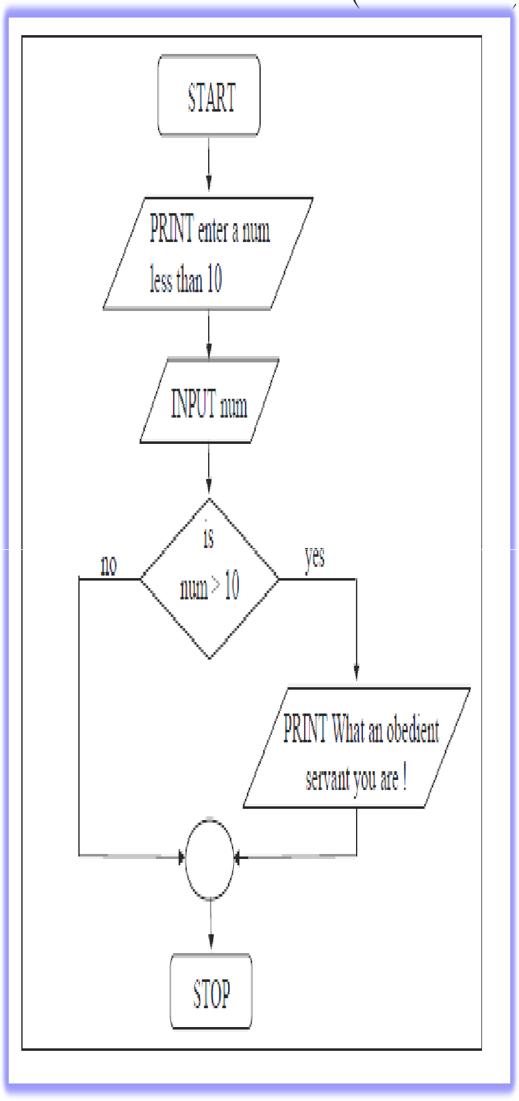
if (contd…)
main()
{
int num;
printf(“Enter a number”) scanf(“%d”,&num); if(num>10)
printf(“What an obedient servant you are”);
}

Slide 44
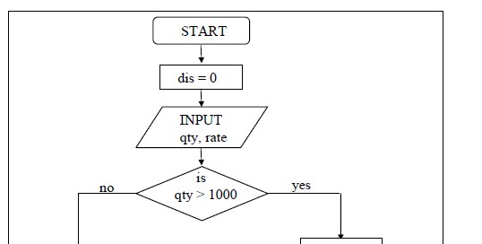
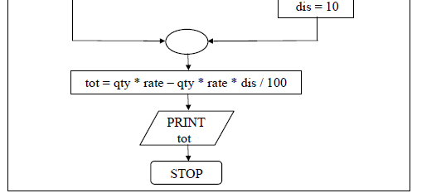
Example: While purchasing certain items, a discount of 10% is offered if the quantity purchased is more than 1000. If quantity and price per item are input through the keyboard, write a program to calculate the total expenses.
main( )
{
int qty, dis = 0 ; float rate, tot ;
printf ( "Enter quantity and rate " ) ;
scanf ( "%d %f", &qty, &rate) ; if ( qty > 1000 )
{
dis = 10 ;
}
tot = ( qty * rate ) - ( qty * rate
* dis / 100 ) ;
printf ( "Total expenses = Rs.
%f", tot ) ;
}

Slide 45
Output
Enter quantity and rate 1200 15.50
Total expenses = Rs. 16740.000000
Enter quantity and rate 200 15.50
Total expenses = Rs. 3100.000000

Slide 46
if vs if else
Cond?
Cond?
T
T
F
S1
S2
S1
F
S2
S3
S3

Slide 47
if vs if else
1. int x;
2. x=7;
3. if(x>5)
{
x=x+1;
printf("New value of x is %d',x);
}
4. printf("x is not greater than 5");
5.

Slide 48
if vs if else
1. int x;
2. x=7;
3. if(x>5)
{
x=x+1;
printf("New value of x is %d',x);
}
else
printf("x is not greater than 5");
4.
5.

Slide 49
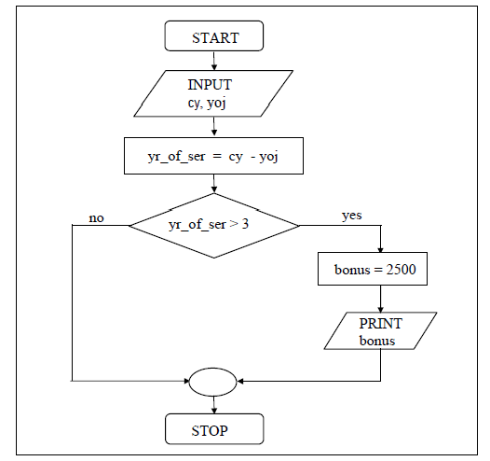
Example : Compound Statement within if
The current year and the year in which the employee joined the organization are entered through the keyboard. If the number of years for which the employee has served the organization is greater than 3, then a bonus of Rs. 2500/- is given to the employee. If the years of service are not greater than 3, then the program should do nothing.
/* Calculation of bonus */ main( )
{
int bonus, cy, yoj, yr_of_ser ; printf ( "Enter current year and year of joining " ) ;
scanf ( "%d %d", &cy, &yoj ) ; yr_of_ser = cy - yoj ;
if ( yr_of_ser > 3 )
{
bonus = 2500 ;
printf ( "Bonus = Rs. %d", bonus ) ;
}
else
{
}
}

Slide 50
Here the expression can be any valid expression including a relational expression. We can even use arithmetic expressions in the if statement. For example all the following if statements are valid.
if ( 3 + 2 % 5 )
printf ( "This works" ) ;
if ( a = 10 )
printf ( "Even this works" ) ;
if ( -5 )
printf ( "Surprisingly even this works" ) ;

Slide 51
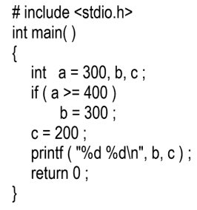
Problems

Slide 52
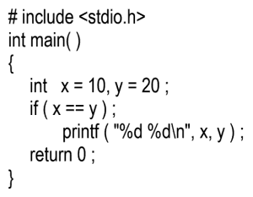

Problems

Slide 53
if-else
The if statement by itself will execute a single statement, or a group of statements, when the expression following if evaluates to true.
It does nothing when the expression evaluates to false.
We can execute one group of statements if the expression evaluates to true and another group of statements if the expression evaluates to false.
In a company an employee is paid as under:
If his basic salary is less than Rs. 1500, then HRA = 10% of basic salary and DA = 90% of basic salary. If his salary is either equal to or above Rs. 1500, then HRA = Rs. 500 and DA = 98% of basic salary. If the employee's salary is input through the keyboard write a program to find his gross salary.

Slide 54
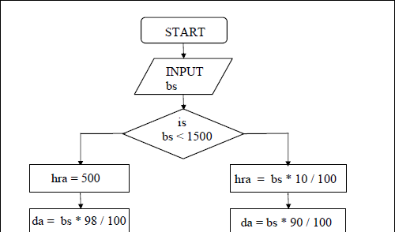
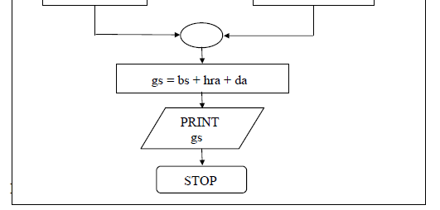
if-else
/* Calculation of gross salary */ main( )
{
float bs, gs, da, hra ;
printf ( "Enter basic salary " ) ;
scanf ( "%f", &bs ) ;
if ( bs < 1500 )
{
hra = bs * 10 / 100 ;
da = bs * 90 / 100 ;
}
else
{
hra = 500 ;
da = bs * 98 / 100 ;
}
gs = bs + hra + da ;
printf ( "gross salary = Rs. %f", gs )
}
;

Slide 55
The group of statements after the if upto and not including the else is called an ‘if block’. Similarly, the statements after the else form the ‘else block’.
Notice that the else is written exactly below the if. The statements in the if block and those in the else block have been indented to the right. This formatting convention is very important to enable you to understand the working of the program better.
If there are only one statement to be executed in the if block and only one statement in the else block we could have dropped the pair of braces.

Slide 56
if-else
if-else is used to make decision based upon certain condition
if (expression) statement 1; else
statement 2;
if (expression)
{
statement 1;
statement 2;
… statement n;
}
else
{
Statement k; Statement z;
… Statement L;
if (a>0)
{
printf(“a is positive”); z=a+b;
}
else
{
printf(“a is negative”); z = a;
}
z =a+b, a>0
z =a , otherwise
if (a>0)
{
printf(“a is positive”);
}
else
printf(“a is negative”);
}

Slide 57
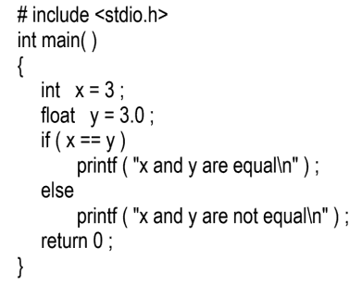

Problems

Slide 58
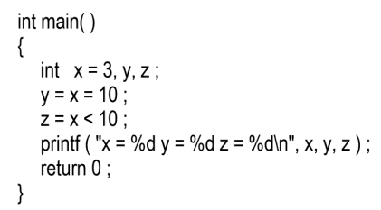

Problems

Slide 59
Problems
# include <stdio.h>
int main( )
{
int x = 3, y, z ;
y = x = 10 ;
z = x <= 10 ;
printf ( "x = %d y = %d z = %d\n", x, y, z ) ;
return 0 ;
}
x=10 y=10 z=1

Slide 60
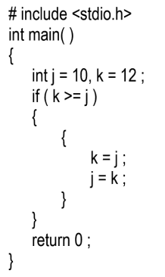
Problems

Slide 61
Problems
# include
int main( )
{
float a = 12.25, b = 12.52 ;
if ( a = b )
printf ( "a and b are equal\n" ) ; return 0 ;
}
a and b are equal

Slide 62
Problems
# include
int main( )
{
int x = 10 ;
if ( x >= 2 ) then
printf ( "%d\n", x ) ;
return 0 ;
}
Error: then undeclared

Slide 63
Problems
# include <stdio.h>
int main( )
{
int a, b ;
scanf ( "%d %d", &a, &b ) ;
if ( a > b ) ;
printf( "This is a game\n" ) ;
else
printf( "You have to play it\n" ) ;
return 0 ;
}
error: ‘else’ without a previous ‘if’

Slide 64
Problems
WAP a program to take a character from keyboard and check whether it is vowel or not. If the character taken from keyboard is small, then display its corresponding capital value and vice versa.

Slide 65
#include<stdio.h>
int main()
{
char ch;
printf("Enter an Alphabet: ");
scanf("%c", &ch);
if(ch=='a' || ch=='e' || ch=='i' || ch=='o' || ch=='u')
{
printf("\n%c is a Vowel\n",ch);
printf("corresponding capital letter is %c",ch-32);
}
else if(ch=='A' || ch=='E' || ch=='I' || ch=='O' || ch=='U')
{
printf("\n%c is a Vowel\n",ch);
printf("corresponding small letter is %c",ch+32);
}
else
printf("\nIt's a Consonant");
return 0;
}

Slide 66
Problems
WAP in C to swap two numbers without using a third variable.

Slide 67
#include <stdio.h>
int main()
{
int x = 10, y = 5;
// Code to swap 'x' and 'y'
x = x + y; // x now becomes 15
y = x - y; // y becomes 10
x = x - y; // x becomes 5
printf("After Swapping: x = %d, y = %d", x, y);
return 0;
}

Slide 68
#include <stdio.h>
int main()
{
int x = 10, y = 5;
// Code to swap 'x' and 'y'
x = x * y; // x now becomes 50
y = x / y; // y becomes 10
x = x / y; // x becomes 5
printf("After Swapping: x = %d, y = %d", x, y);
return 0;
}

Slide 69
Problems
WAP in C to swap two numbers with/without using a third variable.

Slide 70
#include<stdio.h>
int main() {
double first, second, temp;
printf("Enter first number: ");
scanf("%lf", &first);
printf("Enter second number: ");
scanf("%lf", &second);
// value of first is assigned to temp
temp = first;
// value of second is assigned to first
first = second;
// value of temp (initial value of first) is assigned to second
second = temp;
// %.2lf displays number up to 2 decimal points
printf("\nAfter swapping, first number = %.2lf\n", first);
printf("After swapping, second number = %.2lf", second);
return 0;
}

Slide 71
Nested if-elses
Recap of If Else Statements
if n is even
print even
else
print odd

Slide 72
Nested if-elses
The syntax for Nested If Else Statement
//check if the first condition holds
if (condition 1) {
//if the second condition holds
if (condition 2) {
do something
}
//if the second condition does not hold
else {
do something else
}
}
// if the first condition does not hold
else{
//if the third condition holds
if (condition 3) {
do something
}
//if the third condition does not hold
else {
do something else
}
}

Slide 73
Nested if-elses
#include <stdio.h>
int main() {
int n;
scanf("%d", &n);
if (n % 2 == 0) {
printf("Even ");
//nested if else condition to check if n is divisible by 4 or not
if (n % 4 == 0) {
printf("and divisible by 4");
} else {
printf("and not divisible by 4");
}
}
else {
//the number is odd
printf("Odd ");
if (n % 3 == 0) {
printf("and divisible by 3");
} else {
printf("and not divisible by 3");
}
} return 0;
}

Slide 74
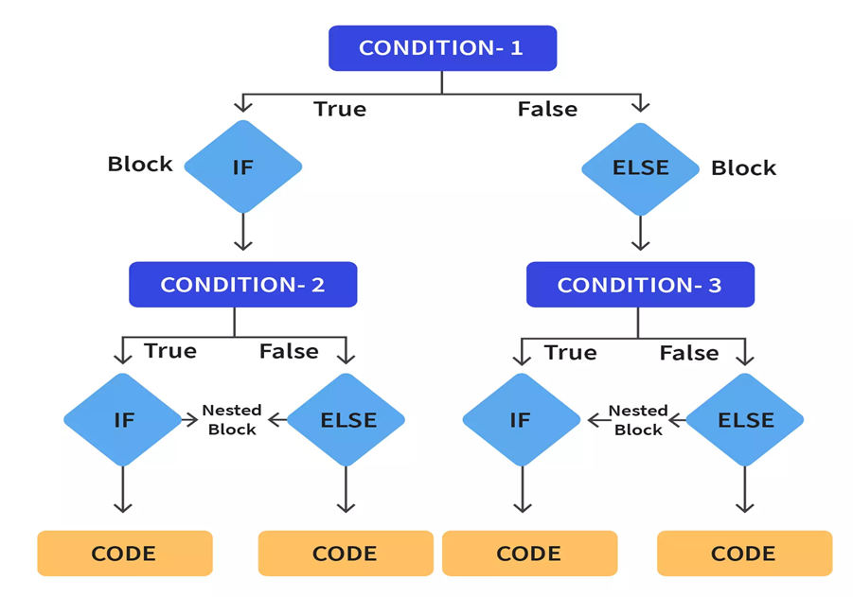
Nested if-elses

Slide 75
Nested if-elses
The nested if-else is, if we write an entire if-else construct within either the body of the if statement or the body of an else statement.
This is called ‘nesting’ of ifs. This is shown in the following program.
/* A quick demo of nested if-else
*/ main( )
{
int i ;
printf ( "Enter either 1 or 2 " ) ; scanf ( "%d", &i ) ;
if ( i == 1 )
{
printf ( "You are male !" ) ;
}
else
{
if ( i == 2 )
printf ( “You are female");
else
printf ( “Gender not verified !" ) ;
}
}

Slide 76
Forms of if
(a) if ( condition ) do this ;
(d) if ( condition )
{
do this ; else
{
do this ; and this ;
}
(f) if ( condition )
{
if (condition ) do this ;
else
{
do this ; and this ;
(b) if ( condition )
{
do this ; and this ;
}
(e) if ( condition )
do this ; else
{
if ( condition ) do this ;
else
{
do this ; and this ;
}
}
}
}
else
do this ;
(c) if ( condition )
do this ; else
do this ;

Slide 77
if-else with logical operator
C allows usage of three logical operators, namely, &&, || and !. These are to be read as ‘AND’ ‘OR’ and ‘NOT’ respectively.
The first two operators, && and ||, allow two or more conditions to be combined in an if statement.
Consider the following example.
Example 2.4: The marks obtained by a student in 5 different subjects are input through the keyboard. The student gets a division as per the following rules:
Percentage above or equal to 60 - First division
Percentage between 50 and 59 - Second division
Percentage between 40 and 49 - Third division
Percentage less than 40 - Fail
Write a program to calculate the division obtained by the student.
There are two ways in which we can write a program for this example. These methods are given below.

Slide 78
if-else with logical operator
/* Method – I */
main( )
{
int m1, m2, m3, m4, m5, per ;
printf ( "Enter marks in five subjects " ) ;
scanf ( "%d %d %d %d %d", &m1, &m2, &m3, &m4, &m5 ) ;
per = ( m1 + m2 + m3 + m4 + m5 ) / 5 ;
if ( per >= 60 )
printf ( "First division ") ;
else
{
if ( per >= 50 )
printf ( "Second division" ) ;
else
{
if ( per >= 40 )
printf ( "Third division" ) ;
else
printf ( "Fail" ) ;
}
}
}

Slide 79
if-else with logical operator
This is a straight forward program. Observe that the program uses nested if-else . This leads to three disadvantages:
As the number of conditions go on increasing the complexity also goes on increasing.
Care needs to be exercised to match the corresponding ifs and elses.
Care needs to be exercised to match the corresponding pair of braces.
.All these three problems can be eliminated by usage of ‘Logical operators’. The following program illustrates this.

Slide 80
/* Method – II */
main( )
{
int m1, m2, m3, m4, m5, per ;
printf ( "Enter marks in five subjects " ) ;
scanf ( "%d %d %d %d %d", &m1, &m2, &m3, &m4, &m5 ) ;
per = ( m1 + m2 + m3 + m4 + m5 ) / 5 ;
if ( per >= 60 )
printf ( "First division" ) ;
if ( ( per >= 50 ) && ( per < 60 ) )
printf ( "Second division" ) ;
if ( ( per >= 40 ) && ( per < 50 ) )
printf ( "Third division" ) ;
if ( per < 40 )
printf ( "Fail" ) ;
}
As can be seen from the second if statement, the && operator is used to combine two conditions. ‘Second division’ gets printed if both the conditions evaluate to true. If one of the conditions evaluate to false then the whole thing is treated as false.

Slide 81
if-else with logical operator
Two distinct advantages can be cited in favour of this program:
The matching (or do I say mismatching) of the ifs with their corresponding elses gets avoided, since there are no elses in this program.
In the previous program the statements went on gradually to the right. This effect becomes more prominent as the number of conditions go on increasing. This would make the task of matching the ifs with their corresponding elses and matching of opening and closing braces that much more difficult.

Slide 82
if-else with logical operator
main()
{
int x=3,y=9,z; if(x>=3 && y == 9) z = x+y;
else
main()
{
int x=3,y=9,z;
main()
{
int x=3,y=9,z=5,k;
^{if(x>=3 || y == 9)} if(x>=3 || y == 9 && z < 5)
z = x+y; else
z = x+y; else
z=x+9;
}
z=x+9;
}
z=x+9;
}

Slide 83
/* else if ladder demo */
main( )
{
int m1, m2, m3, m4, m5, per ;
per = ( m1+ m2 + m3 + m4+ m5 ) / per ;
if ( per >= 60 )
printf ( "First division" ) ;
else if ( per >= 50 )
printf ( "Second division" ) ;
else if ( per >= 40 )
printf ( "Third division" ) ;
else
printf ( "fail" ) ;
}
You can note that this program reduces the indentation of the statements. In this case every else is associated with its previous if. The last else goes to work only if all the conditions fail. Even in else if ladder the last else is optional

Slide 84
The marks obtained by a student in 5 different subjects are input through the keyboard. The student gets a division as per the following rules:
Percentage above or equal to 80 - Distinction Percentage between 60 and < 80 - Second division Percentage between 50 and < 60 – Second Division Percentage less than 40 and < 50 – Third Division
Percentage less than 40 and fail in either one of the subject - Fail

Slide 85
#include<stdio.h>
main()
{
int english,math,history,nepali,science; float percentage;
printf("Enter marks in 5 subjects"); scanf("%d %d %d %d
%d",&english,&math,&history,&nepali,&science
);
if(english>=40 && math>=40 && history>=40 && nepali>=40 && science>=40)
{
if(english<=100 && math <=100 &&
else if(percentage>=60 && percentage<80) printf("First Division\n");
else if(percentage>=50 && percentage<60) printf("Second Division\n");
else
printf("Third Division\n");
}
else
printf("Your marks is greater than 100 which is not possible\n");
}
else
history<=100 && nepali<=100 && science<=100)
{
percentage=(english+math+science+history+nepal i)/5.0;
printf("\"Congratulation you have passed all subjects\"\n");
printf("Your have secured
%5.2f%%\n",percentage); if(percentage>=80 && percentage<=100 ) printf("Distinction\n");
printf("Sorry!!! you are fail\n");
}

Slide 86
Problems
Triangle consists of three sides and three angles. Based on the three sides, there are three types of triangle −
Equilateral triangle: All three sides are equal.
Isosceles triangle: All two sides are equal.
Scalene triangle: No sides are equal.
Write a C program to check whether the triangle is equilateral, isosceles or scalene

Slide 87
Problems
#include<stdio.h>
int main(){
int side1, side2, side3;
printf("Enter sides of triangle:");
scanf("%d%d%d",&side1,&side2,&side3);
if(side1 == side2 && side2 == side3)
printf("The Given Triangle is equilateral");
else if(side1 == side2 || side2 == side3 || side3 == side1)
printf("The given Triangle is isosceles");
else
printf("The given Triangle is scalene
");
return 0;
}
Run1:
Enter sides of triangle:3 4 6
The given Triangle is scalene
Run2 :
Enter sides of triangle:2 2 5
The given Triangle is isosceles
Run 3:
Enter sides of triangle:5 5 5
The Given Triangle is equilateral

Slide 88
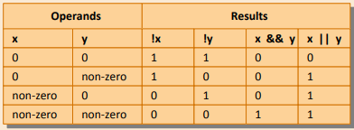
The following figure summarizes the working of all the three logical operators.

Slide 89
The following figure summarizes the working of all the three logical operators.

Slide 90
Examples of Logical Operators in C
#include <stdio.h>
main() {
int p = 5;
int q = 20;
int r ;
if ( p || q ) {
printf(“Line 5 – Condition is true\n” );
}
if ( p && q ) {
printf(“Line 6 – Condition is true\n” );
}
/* let’s change the value of p and q */
p = 0;
q = 10;
if ( !(p && q) ) {
printf(“Line 7 – Condition is true\n” );
}
if ( p && q ) {
printf(“Line 8 – Condition is true\n” );
} else {
printf(“Line 8 – Condition is not true\n” );
}
}
Line 5 – Condition is true
Line 6 – Condition is true
Line 7 – Condition is true
Line 8 – Condition is not true

Slide 91
Ternary operators
The conditional operators ? and : are sometimes called ternary operators since they take three arguments.
Their general form is,
expression 1 ? expression 2 : expression 3
What this expression says is: “if expression 1 is true (that is, if its value is non-zero), then the value returned will be expression 2, otherwise the value returned will be expression 3”.

Slide 92
We use the ternary operator in C to run one code when the condition is true and another code when the condition is false.
For example,
(age >= 18) ? printf("Can Vote") : printf("Cannot Vote");

Slide 93
Example :
#include <stdio.h>
int main() {
int age;
// take input from users
printf("Enter your age: ");
scanf("%d", &age);
// ternary operator to find if a person can vote or not
(age >= 18) ? printf("You can vote") : printf("You cannot vote");
return 0;
}

Slide 94
Example
int x, y ;
scanf ( "%d", &x ) ;
y = ( x > 5 ? 3 : 4 ) ;
This statement will store 3 in y if x is greater than 5,
otherwise it will store 4 in y.
The equivalent if-else form would be,
if ( x > 5 )
y = 3 ;
else
y = 4 ;

Slide 95
Assign the ternary operator to a variable
In C programming, we can also assign the expression of the ternary operator to a variable. For example,
variable = condition ? expression1 : expression2;

Slide 96
Assign the ternary operator to a variable
#include <stdio.h>
int main() {
// create variables
char operator = '+';
int num1 = 8;
int num2 = 7;
// using variables in ternary operator
int result = (operator == '+') ? (num1 + num2) : (num1 - num2);
printf("%d", result);
return 0;
}

Slide 97
Problem
Find out the given number is even or not using Ternary Operator

Slide 98
Problem
#include <stdio.h>
int main() {
int number = 3;
(number % 2 == 0) ? printf("Even Number") : printf("Odd Number");
return 0;
}

Slide 99
Problem
Find the maximum number from the given two integer with the Ternary Operator.

Slide 100
Problem
#include<stdlib.h>
int main()
{
int num1, num2,mxNumber;
num1 = 100;
num2 = 20;
// result = condition ? exp1 : exp2;
mxNumber = num1 >= num2 ? num1 : num2;
printf("Maximum Number from %d and %d is %d",num1,num2, mxNumber);
return 0;
}

Slide 101
nested ternary operators
#include<stdio.h>
int main()
{
int a, b, c, max;
printf("Enter any three numbers\n");
scanf("%d%d%d", &a, &b, &c);
max= (a > b) ? (a > c ? a : c) : (b > c ? b : c);
printf ("%d", max);
printf (" is the largest number of given numbers");
return 0;
}

Slide 102
Exercise
# include <stdio.h>
int main( )
{
int i = 4, z = 12 ;
if ( i = 5 || z > 50 )
printf ( "True\n" ) ;
Else
printf ( "False\n" );
return 0;
}
True

Slide 103
Exercise
#include <stdio.h>
int main( )
{
int i = 4, j = -1, k = 0, w, x, y, z ;
w = i || j || k ;
x = i && j && k ;
y = i || j && k ;
z = i && j || k ;
printf ( "w = %d x = %d y = %d z = %d\n", w, x, y, z ) ;
return 0 ;
}
w = 1 x = 0 y = 1 z = 1

Slide 104
Problem
A company insures its drivers in the following cases:
If the driver is married.
If the driver is unmarried, male & above 30 years of age.
If the driver is unmarried, female & above 25 years of age.

Slide 105
/* Insurance of driver - using logical operators */
main( )
Insurance of driver - without using logical operators */
main( )
{
char sex, ms ; int age ;
printf ( "Enter age, sex, marital status " ) ;
scanf ( "%d %c %c", &age, &sex, &ms ) ;
if ( ms == 'M' )
printf ( "Driver is insured" ) ;
else
{
if ( sex == 'M' )
{
if ( age > 30 )
printf ( "Driver is insured" ) ;
else
printf ( "Driver is not insured" ) ;
}
else
{
if ( age > 25 )
printf ( "Driver is insured" ) ;
else
printf ( "Driver is not insured" ) ;
}
}
}
{
char sex, ms ; int age ;
printf ( "Enter age, sex, marital status " ) ;
scanf ( "%d %c %c" &age, &sex, &ms ) ;
if ( ( ms == 'M') || ( ms == 'U' && sex == 'M' && age > 30 ) || ( ms == 'U' && sex == 'F' && age > 25 ) )
printf ( "Driver is insured" ) ;
else
printf ( "Driver is not insured" ) ;
}

Slide 106
The switch-case Statement
–Switch-case-default
–Multiple branch selection statement
–Tests the value of an expression against a list of integer or char constants
–When a match is found, then statement associated with that constant is executed.
Syntax of switch...case
switch (expression)
​{
case constant1: statements
break;
case constant2: statements
break; .
default: default statements
}

Slide 107
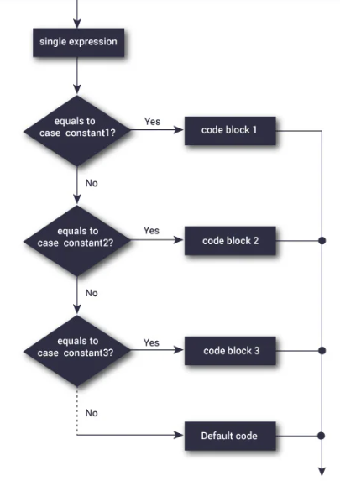
Switch Statement Flowchart

Slide 108
The switch-case Statement contd…
Operation: the expression is evaluated; then execution continues at the statements following the case statement that matches the result or after the label default if there are no matches. If the default case does not exist, then execution continues after the last case statement.
Execution continues through remaining cases in the switch structure unless the break instruction is encountered. If a break is encountered, then execution continues after the present switch- case instance.

Slide 109
switch ( integer expression )
{
case constant 1 : do this ;
case constant 2 : do this ;
case constant 3 : do this ;
default : do this ;
}
main( )
{
int i = 2 ; switch ( i )
{
case 1 :
printf ( "I am in case 1 \n" ) ; break;
case 2 :
printf ( "I am in case 2 \n" ) ; break;
case 3 :
printf ( "I am in case 3 \n" ) ; break;
default :
printf ( "I am in default \n" ) ;
}
}

Slide 110
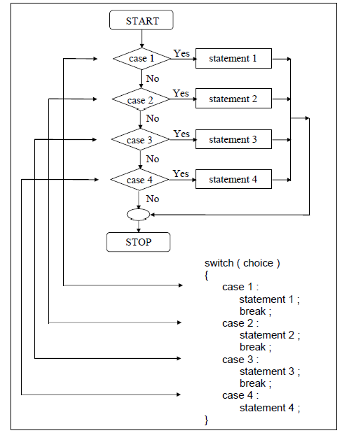

Slide 111
main( )
{
int i = 22 ; switch ( i )
{
case 121 :
printf ( "I am in case 121 \n" ) ; break ;
case 7 :
printf ( "I am in case 7 \n" ) ; break ;
main( )
{
char c = 'x' ; switch ( c )
{
case 'v' :
printf ( "I am in case v \n" ) ; break ;
case 'a' :
printf ( "I am in case a \n" ) ; break ;
case 22 :
printf ( "I am in case 22 \n" ) ; break ;
default :
printf ( "I am in default \n" ) ;
}
}
case 'x' :
printf ( "I am in case x \n" ) ; break ;
default :
printf ( "I am in default \n" ) ;
}
}

Slide 112
switch ( ch )
{
case 'a' :
case 'A' :
printf ( "a for apple" ) ; break ;
case 'b' :
case 'B' :
printf ( "b for ball" ) ; break ;
case 'c' :
case 'C' :
printf ( "c for cat" ) ; break ;
default :
Valid Switch Expression
switch ( i + j * k )
switch ( 23 + 45 % 4 * k )
switch ( a < 4 && b > 7 )
printf ( “Capital A,B or C and small a, b, c is not stored in ch" ) ;
}
}

Slide 113
Avoid
A float expression cannot be tested using a switch
Cases can never have variable expressions (for example it is wrong to say case a +3 : )
Multiple cases cannot use same expressions. Thus the following
switch is illegal:
{
case 3 :
...
case 1 + 2 :
...
}

Slide 114
Using switch- case
a) WAP that will output following
x= a+b if y=2 x= a-b if y=4 x= a*b if y=0 x= a/b if y= 1
x= a%b, otherwise

Slide 115
#include<stdio.h>
int main()
{
int y,a=5,x,b=2;
scanf("%d",&y);
switch(y)
{
case 2: x=a+b;
break;
case 4: x=a-b;
break;
case 0: x= a*b;
break;
case 1: x=a/b;
break;
default: x=a%b;
}
printf("x=%d",x);
}

Slide 116
Using switch- case
a) WAP that will output following
x= a+b if y=‘+’
x= a-b if y=‘-’
x= a*b if y=‘*’
x= a/b if x= a%b,
y= ‘/’ otherwise

Slide 117
#include<stdio.h>
int main()
{
int a=5,x,b=2; char y;
scanf("%c",&y);
switch(y)
{
case '+': x=a+b;
break;
case '-': x=a-b;
break;
case '*': x= a*b;
break;
case '/': x=a/b;
break;
default: x=a%b;
}
printf("x=%d",x);
}

Slide 118
Problem
WAP that will calculate area of the following entities.
If user enter value 1,your program will display area of circle
If user enter value 2,your program will display area of triangle
If user enter value 3,your program will display area of rectangle
Other wise your program will display “Please enter either 1 or 2 or 3”

Slide 119
#include<stdio.h> int main()
{
int choice,length,breadth,base,height; float radius,area;
printf("Enter value 1 or 2 or 3 to\ncalulate either area of circle\n or area of triangle or \narea of rectangle");
case 2: printf("Enter base and height"); scanf("%d %d",&base,&height); area=1.0/2*base*height; printf("area of triangle
is=%f",area);
break;
case 3: printf("Enter length and breadth\n");
scanf("%d
%d",&length,&breadth);
area=length*breadth;
scanf("%d",&choice); switch(choice)
{
case 1: printf("Enter radius");
scanf("%f",&radius); area=3.14*radius*radius; printf("area of circle
is=%f",area);
break;
printf("area of rectangle is=%f",area);
break;
default: printf("donot press any key except 1 or 2 or 3");
}
return 0;
}

Slide 120
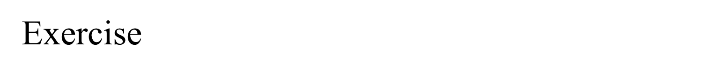
# include <stdio.h>
int main( )
{
int k, num = 30 ;
k = ( num > 5 ? ( num <= 10 ? 100 : 200 ) : 500 ) ;
printf ( "%d\n", num ) ;
return 0 ;
}

Slide 121
# include <stdio.h>
int main( )
{
int k, num = 30 ;
k = ( num > 5 ? ( num <= 10 ? 100 : 200 ) : 500 ) ;
printf ( "%d\n", num ) ;
return 0 ;
}
30

Slide 122
# include <stdio.h>
int main( )
{
char suite = 3 ;
switch ( suite )
{
case 1 :
printf ( "Diamond\n" ) ;
case 2 :
printf ( "Spade\n" ) ;
default :
printf ( "Heart\n" ) ;
}
printf ( "I thought one wears a suite\n" ) ;
return 0 ;
}

Slide 123
# include <stdio.h>
int main( )
{
char suite = 3 ;
switch ( suite )
{
case 1 :
printf ( "Diamond\n" ) ;
case 2 :
printf ( "Spade\n" ) ;
default :
printf ( "Heart\n" ) ;
}
printf ( "I thought one wears a suite\n" ) ;
return 0 ;
}
Heart
I thought one wears a suite

Slide 124
# include <stdio.h>
int main( )
{
int c = 3 ;
switch ( c )
{
case '3' :
printf ( "You never win the silver prize\n" ) ;
break ;
case 3 :
printf ( "You always lose the gold prize\n" ) ;
break ;
default :
printf ( "Of course provided you win a prize\n" ) ;
}
return 0 ;
}

Slide 125
# include <stdio.h>
int main( )
{
int c = 3 ;
switch ( c )
{
case '3' :
printf ( "You never win the silver prize\n" ) ;
break ;
case 3 :
printf ( "You always lose the gold prize\n" ) ;
break ;
default :
printf ( "Of course provided you win a prize\n" ) ;
}
return 0 ;
}
You always lose the gold prize

Slide 126
# include <stdio.h>
int main( )
{
int i = 3 ;
switch ( i )
{
case 0 :
printf ( "Customers are dicey\n" ) ;
case 1 + 0 :
printf ( "Markets are pricey\n" ) ;
case 4 / 2 :
printf ( "Investors are moody\n" ) ;
case 8 % 5 :
printf ( "At least employees are good\n" ) ;
}
return 0 ;
}

Slide 127
# include <stdio.h>
int main( )
{
int i = 3 ;
switch ( i )
{
case 0 :
printf ( "Customers are dicey\n" ) ;
case 1 + 0 :
printf ( "Markets are pricey\n" ) ;
case 4 / 2 :
printf ( "Investors are moody\n" ) ;
case 8 % 5 :
printf ( "At least employees are good\n" ) ;
}
return 0 ;
}
At least employees are good

Slide 128
# include <stdio.h>
int main( )
{
int suite = 1 ;
switch ( suite ) ;
{
case 0 ;
printf ( "Club\n" ) ;
case 1 ;
printf ( "Diamond\n" ) ;
}
return 0 ;
}

Slide 129
# include <stdio.h>
int main( )
{
int suite = 1 ;
switch ( suite ) ;
{
case 0 ;
printf ( "Club\n" ) ;
case 1 ;
printf ( "Diamond\n" ) ;
}
return 0 ;
}
error: expected ‘:’ after case
Unexpected ‘;’ after switch

Slide 130
# include <stdio.h>
int main( )
{
int x = 20, y = 40, z = 45 ;
if ( x > y && x > z )
printf ( "biggest 1= %d\n", x ) ;
else if ( y > x && y > z )
printf ( "biggest 2= %d\n", y ) ;
else if ( z > x && z > y )
printf ( "biggest 3= %d\n", z ) ;
return 0 ;
}

Slide 131
# include <stdio.h>
int main( )
{
int x = 20, y = 40, z = 45 ;
if ( x > y && x > z )
printf ( "biggest 1= %d\n", x ) ;
else if ( y > x && y > z )
printf ( "biggest 2= %d\n", y ) ;
else if ( z > x && z > y )
printf ( "biggest 3= %d\n", z ) ;
return 0 ;
}
biggest 3= 45

Slide 132
# include <stdio.h>
int main( )
{
int i = 10, j = 20 ;
if ( i = 5 ) && if ( j = 10 )
printf ( "Have a nice day\n" ) ;
return 0 ;
}

Slide 133
# include <stdio.h>
int main( )
{
int i = 10, j = 20 ;
if ( i = 5 ) && if ( j = 10 )
printf ( "Have a nice day\n" ) ;
return 0 ;
}
Error: Condition should be if(i==5 && j==10)

Slide 134
# include <stdio.h>
int main( )
{
int i = 10, j = 10 ;
if ( i && j == 10 )
printf ( "Have a nice day\n" ) ;
return 0 ;
}

Slide 135
# include <stdio.h>
int main( )
{
int i = 10, j = 10 ;
if ( i && j == 10 )
printf ( "Have a nice day\n" ) ;
return 0 ;
}
Have a nice day

Slide 136
Thank You

